Slide 1
Activity Fund 2023-2024
ACTIVITY FUND TOOL KIT
***Purple font - for clarification Purposes***

Slide 2
“You’re never wrong for doing the right thing…..but that doesn’t mean it’s easy.”
- Mark Twain

Slide 3
Oklahoma Law
The following information was written to help aid School Activity Fund sponsors, teachers, secretaries, and students in the proper procedures for handling School Activity Funds.
It is imperative for every person who handles School Activity Funds to have training in this area per the State of Oklahoma and our School Auditor.
Portions of this handbook are taken from the Oklahoma School Law book and the Board of Education Policy Manual and will be updated periodically.
The Board of Education shall exercise control over all funds on hand or hereafter received or collected, as herein provided, from student or other extracurricular activities conducted in the school district. Such funds shall be deposited to the credit of the account maintained for the benefit of the particular activity within the School Activity Fund. (Title 70 Section 5-129of the Oklahoma Statutes)
It is important to have a clear understanding of the function and purpose of each account to avoid misapplication of funds. The purpose of Activity Fund accounts is generally understood by the account titles, written descriptions such as charters, etc., and by customary usage of the account. The purpose of each Activity Fund Account is approved by the Liberty Board of Education each year.
The organization must comply with all state and federal laws as well as Board policies.
Outside organizations may not use the District’s federal tax ID number to make purchases they must have their own federal tax ID number.

Slide 4
Building Principal Responsibilities
RESPONSIBILITIES OF THE BUILDING PRINCIPAL: Per Oklahoma State Law - Building Principals, being responsible for their school’s overall program, are accountable for knowing and enforcing all rules governing School Activity Funds. Although administrative styles may vary, the basic duties required of all principals are as follows:
1. To appoint staff members to perform the duties of sponsors, who would be available at various times throughout the school day.
2. To inform the sponsor of the nature and extent of authority regarding the School Activity Fund.
3. To inform the sponsor of the practices and procedures which are acceptable and within the rules and regulations governing student body activities as a whole.
4. To select appropriate sponsors to represent all authorized student groups. The sponsor will conduct all fundraising activities.
5. To be certain that every responsibility and authority is properly delegated and thoroughly understood by those upon whom such authority is conferred.
6. To periodically evaluate the performance of each sponsor involved to determine that all functional duties are being carried out adequately.
7. To inform all faculty members - especially new teachers concerning the proper use of funds and proper purchasing procedures.
8. To report to the Superintendent or Business Manager cases of theft or suspected theft of cash and/or merchandise belonging to the School Activity Fund. This information must be reported immediately to the Superintendent – a report in this case isn’t limited to the Building Principal - if you have witnessed mishandling of funds or merchandise – if you know about it – you must report it.

Slide 5
Responsibility of Sponsors
RESPONSIBILITIES OF SPONSORS: Sponsors for any group, club, or student organization are responsible for the following duties depending on the nature of the organization:
1. Work closely with the group and give supervision and guidance to student officers exerting leadership and counsel where required.
2. Activity Funds or Sanctioned Booster Clubs CANNOT buy gift cards for any reason.
3. Organize and conduct student projects and ascertain that all receipts are properly accounted for on the Transmittal Form and deposited with the activity fund secretary.
4. Plan in advance. Determine purchasing needs. Fill out requisitions to obtain approval prior to the actual purchase. Many emergency requisitions and violations of purchasing procedures can be avoided by pre-planning. Furthermore, sponsors should bear in mind that when they make purchases prior to proper approval and issuance of a purchase order, they do so at their own financial risk!
5. Make sure you are following all procedures – 99.999% of all activity will begin with a Purchase Order Requisition!
5. Inspect materials received and authorize payment when delivery is complete and quality of merchandise is determined to be satisfactory. The sponsor’s signature on the invoice signifies that the claim is approved for payment. If you receive an invoice by email be sure you are signing the invoice and sending to Carolyn Wiggin.

Slide 6
Responsibility of Sponsor ~continued~
6. Submit all fundraiser requests in a timely manner to the Activity Fund Director, Colby Wade,
7. Note on the requisition if shipping/handling is free. Be sure to estimate charges at 20% of your total purchase, if actual charges are unknown.
8. Accounts cannot operate in a negative balance. (Illegal to run an account in the negative!)
9. Students are not allowed to checkout and/or use school credit cards to make purchases.
10. Students are not allowed to transport monies for sponsors.
11. All school credit cards (Walmart, Sams, Visa) and receipts must be returned as soon as possible preferably the same day or the very next day.

Slide 7
ACTIVITY FUND SECRETARY PROCEDURES FOR RECEIPTING MONEY
1.The Activity Fund secretary will verify all revenue/transmittals received from each sub-account (project number) sponsor, make sure the sub-account receipts balance with the collections, and give a signed receipt to the sponsor. All discrepancies in deposits will be resolved before sending final deposit to the Activity Fund Custodian. For Clarity: All Deposits, Purchase Order Requisitions for General Fund or Activity Fund or any other items that need to be delivered to the administration office will be picked up each day at 9:00 a.m. and 12:30 p.m.
2. All receipts sent to the District Activity Fund Custodian must show the sub account number and the revenue source i.e. Fundraiser: t-shirt, candy bar sales, etc.
3. All deposit slips and receipts must clearly define the revenue source (fundraiser: t-shirts, candy bar sales). If an organization has more than one fundraiser at a time, the revenue must be receipted separately.
4. A current phone number and address must be on all checks. Write the sub-account number on the back of the check. Make a copy of all checks before sending to the central office. We reserve the right to not accept checks from community members who have a history of insufficient checks – simply ask them to send cash.
5. The designated school personnel will deposit funds into the bank every day. The bank deposit slip and all supporting documentation will be sent to the District Activity Fund Custodian for receipting on the school district’s software program.
6. The District Activity Fund Custodian will send a copy of the transmittal to the sponsor – please keep these for your records.

Slide 8
Responsibilities of the Activity Fund Custodian
RESPONSIBILITIES OF THE DISTRICT ACTIVITY FUND CUSTODIAN:
1. The District Activity Fund Custodian is responsible for maintaining an accurate account of each sub-account (project number) within the district.
2. Posts all deposits to proper sub-accounts.
3. Issues all disbursements; ensures that sub-accounts do not have a negative balance; notifies the sponsor when funds are not sufficient; has proper documentation attached; insures two signatures are attained on the check.
4. Reconciles bank statements each month.
5. Issues a monthly financial report to the Board of Education.
6. Prepares all activity fund records/reports and presents them to the school district auditor.
7. Available to assist school secretaries and sponsors specifically on Thursdays and Fridays.
8. Collects returned checks for non-sufficient funds.
9. Activity Fund Custodian will generate and send a monthly financial statement for each sub-account by the 15th of each month following balancing with bank Statement.

Slide 9
Procedures for Purchasing
PROCEDURES FOR PURCHASING
1. Before making any purchase, a purchase order request must be properly completed and approved and must have back-up information i.e. quotes; shopping cart; invitations; entry fees etc. The PO must include quantity, item name, item number, description, and cost. If the request form is not properly filled out, it will be returned to the sponsor.
2. All purchases made from School Activity Funds must be for the benefit of the students, e.g., entry fees for contest, field trips, classroom supplies, etc. Any classroom items acquired will be added to the school inventory – if the item was purchased with school funds the item(s) remains with the school.
3. The invoiced costs of the purchase order cannot exceed the estimated costs by more than fifteen percent (15%).
4. Each request is to be used only for the purpose intended. Any additional purchases will require another purchase order and approved by the Principal/Superintendent/ AF Director and AF Custodian.
5. Upon approval the requisition will have a purchase order number assigned and will be routed back to the sponsor or authorized person to place the order with the vendor. Please provide the purchase order number to the vendor when placing the order.
6. Under no circumstances should any expenditure be made from collections or cash on hand! This is in direct violation of state law and is expressly forbidden.

Slide 10
Purchase Order Procedures
INITIATE PURCHASE ORDER BY FILLING OUT ALL VENDOR INFORMATION AND A FULL DESCRIPTION OF WHAT IS BEING ORDERED AND THE COST.
SIGN THE PURCHASE REQUISITION
HAVE YOUR BUILDING PRINCIPAL/ACTIVITY FUND SECRETARY/ACTIVITY FUND DIRECTOR/ATHLETIC DIRECTOR/ACTIVITY FUND CUSTODIAN SIGN THE PURCHASE ORDER REQUISITION For clarity: These are people that could be signing off on your P.O. the list is intended to be a reference. All Purchase Order Requisitions will begin with your Building Principal unless it is an athletic purchase order in that case it begins with the Athletic Director and then should go to the Building Principal.
FORWARD TO SUPERINTENDENT’S OFFICE
SUPERINTENDENT WILL APPROVE OR DISAPPROVE AND SIGN OFF - IF APPROVED
P.O. WILL COME TO THE ACTIVITY FUND CLERK AND WILL SIGN AND ASSIGN A P.O. NUMBER – YOU MAY NOT MAKE A PURCHASE WITHOUT P.O. NUMBER.
ACTIVITY FUND SECRETARY WILL SEND BACK TO YOU (PINK AND YELLOW COPIES) - YOU MAY THEN PLACE YOUR ORDER.
WHEN ORDER ARRIVES IN FULL - SEND THE SIGNED (Original) INVOICE OR SALES TICKET TO THE CENTRAL OFFICE FOR PAYMENT PROCESSING.
ALL ATHLETIC PURCHASE ORDERS WILL GO THROUGH COLBY WADE FOR APPROVAL AND THEN PROCEDE TO OBTAIN REMAINING SIGNATURES.
Additional Information: when taking students on trips and you are paying for a meal – you must include a list of all students and any adults (chaperones and sponsors) that are eating with the school organization or team; an itemized receipt is required for any meals paid for with school funds.

Slide 11
Purchase Order Procedures ~Continued~
Do not hold invoices. Vendors must be paid in a timely manner. This also eliminates the possibility of invoices being lost.
The purchase order will be closed upon receipt of an invoice for product(s). No other purchases will be permitted on the same purchase order. THERE IS NEVER AN EXCUSE TO RE-USE; RECYCLE; PIGGY-BACK OR ADD-ON TO AN EXISTING AND/OR ASSIGNED PURCHASE ORDER NUMBER – ANY ADDITIONAL ITEMS THAT YOU NEED TO ORDER WILL REQUIRE ON A NEW PURCHASE ORDER (P.O.)
Carolyn cannot give you a Purchase Order number over the phone – she must have the actual paperwork with all signatures to assign a Purchase order number.
The Purchase Order cut-off date is April 15th each and every year. Why? Because there is a very short time to order a product and get it back before the end of school. Make every effort to get out in front of this date including items that might be needed for graduation; prom; Senior Trip, etc. Even if you are not certain of the cost put in a purchase order with an estimated amount.
Do not turn in Purchase Orders at the end of the year that could wait until after July 1st.

Slide 12
Purchase Order Procedures ~Continued~
***********IMPORTANT ************
IF AN ORDER IS PLACED PRIOR TO APPROVAL, YOU DO SO AT YOUR OWN FINANCIAL RISK! REMEMBER YOU WILL BE RESPONSIBLE FOR PAYMENT OF THE ORDER OR SEND IT BACK.

Slide 13
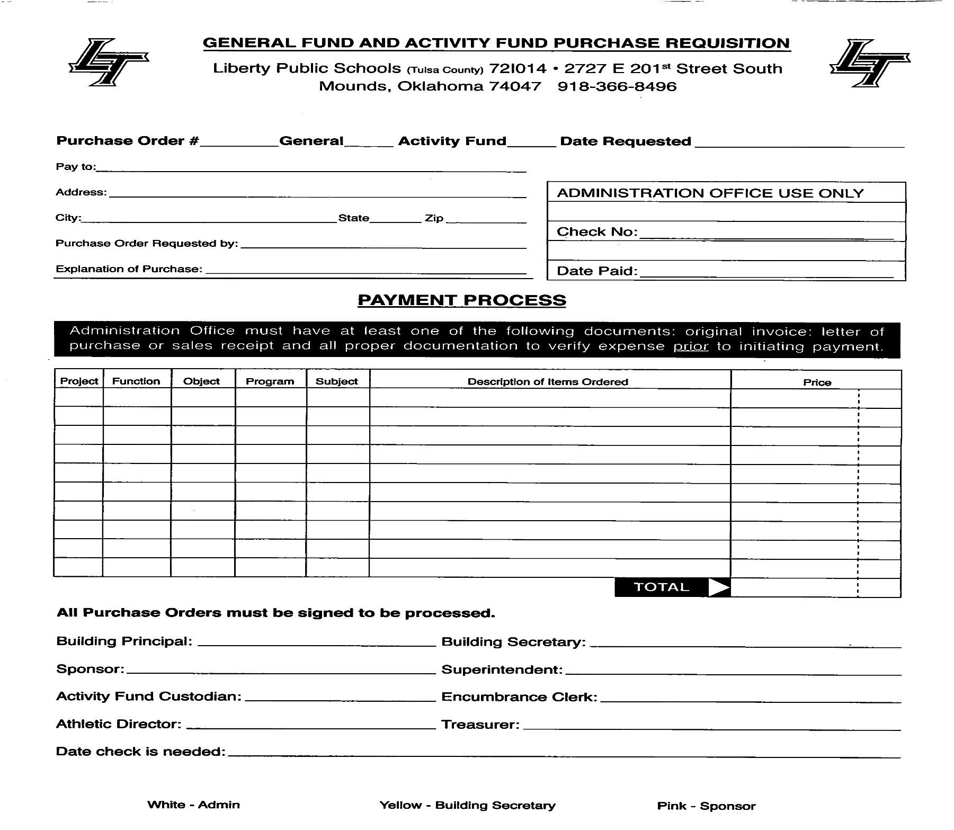
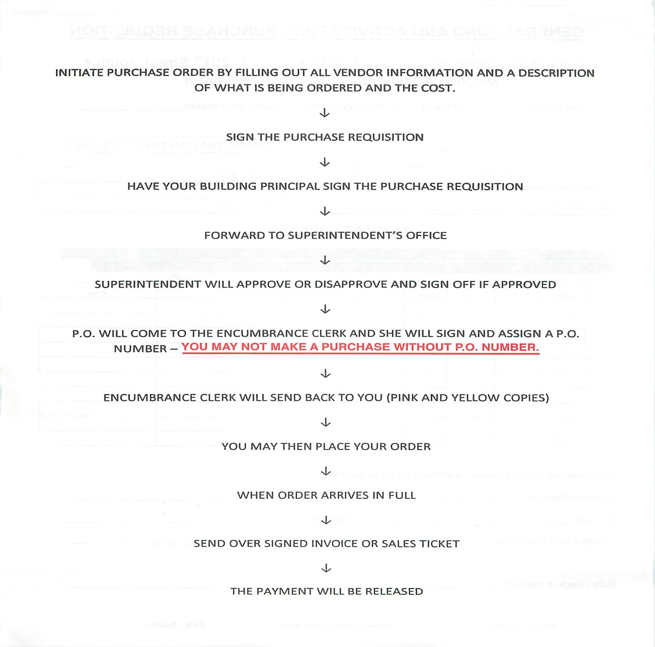
Purchase Order Form (sample)

Slide 14
Fundraisers
Before any fundraiser can begin a Fundraising Activity Request form must be filled out entirely and submitted to the School Office or appropriate administrator. All Fundraisers require Board Approval- usually at the September Board of Education Meeting.
If a purchase is required to start a fundraiser – you must fill out a purchase order request (follow PO Procedures) Do not place an order before PO number is assigned – no exceptions (State Law). Attach a copy of the approved fundraiser form to the purchase order requisition form. If more than one order for the fundraiser is required - then make copies of your approved fundraiser form and attach to each PO to be submitted.
If start-up cash is required. A PO must be filled out for start-up cash and a separate transmittal will be required for the return of funds. Cash may never be held out to start another fundraiser. Each fundraiser is a separate function and must be recorded as such. You cannot re-pay yourself out of student raised funds.
Ensure with your Building Principal the dates that your fundraiser is to begin and when it is to end. (specific dates). Administration sets the fundraising calendar.
All fundraiser student collection forms (i.e. Ribs sales; Blue and Gold; etc) will be submitted with Transmittal. Fundraiser collection forms must add up to receipts written and transmittal total. Transmittal must equal amount of deposit.
All Events requiring printed tickets i.e. dances and banquets need to be pre-numbered, contain the current school year and all unused tickets must be turned in with the transmittal form.
If you are planning to use a school building to host your activities you must reserve the building or facility with an administrator. It will be first-come-first-served.

Slide 15
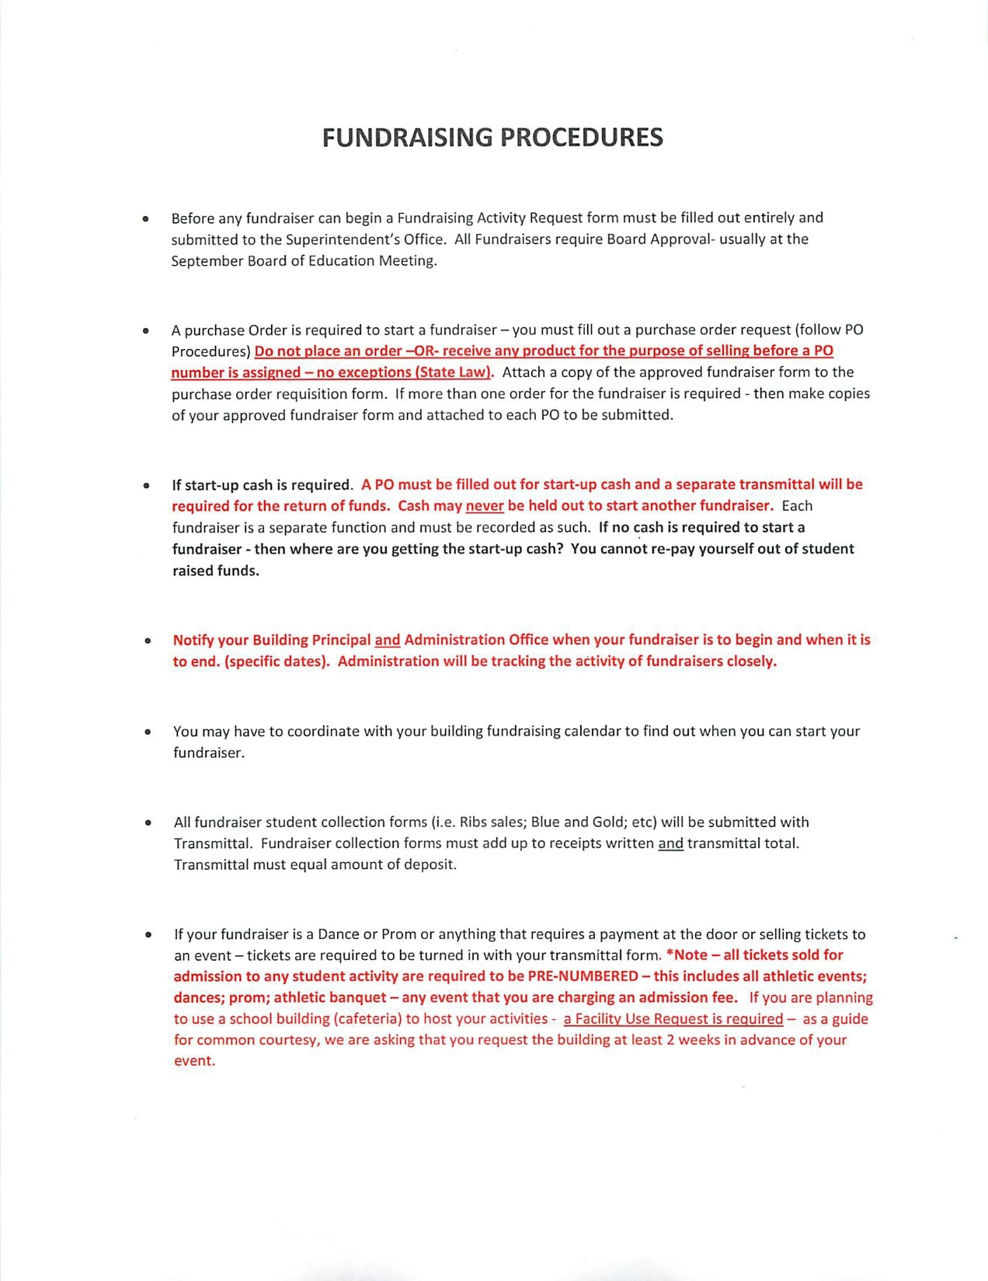
Fundraiser Form (Sample)

Slide 16
Procedures for Collecting and Receipting Money
SPONSOR PROCEDURES FOR RECEIPTING MONEY
1. A receipt shall be issued for all daily collections. Receipt books will be issued in triplicate, with one (1) copy distributed to the individual, one (1) copy shall remain in receipt book and the final copy will be turned into the school secretary with supporting collections. If you make a mistake on a receipt – leave it in the book and write VOID on it – DO NOT TEAR OUT **For Clarity: The original receipt should come over with the transmittal; the yellow should go to the customer, if not, send along with transmittal and the pink copy stays in the receipt book – do not tear the pink copy out of the receipt book - this is the last line of transparency.
2. Sponsors will fill out a transmittal and take it, along with all his/her receipts and collections, to Activity Fund Secretary, Heather Coffelt, to verify deposits.
3. A current phone number and address must be on all checks. DO NOT ACCEPT TEMPORARY CHECKS – EVER - Write the sub-account (project number) on the back side of the check and make a copy of each check.
4. Sponsors should direct students to bring money at specific times.
5. Sponsors should not collect money after school hours if an administrator is not available to secure the collections in the school safe – again funds should never leave the campus.
6. Sponsors CANNOT receipt themselves for money collected! Each student/person turning in money must be written a receipt & a copy of that receipt must accompany the deposit.

Slide 17
Procedures for Collecting and Receipting Money
7. Sponsors should keep all transmittal copies (pink deposit sheets) returned from the Business Office. This shows how much money has been deposited into your account.
8. Your account should be treated as a checkbook. You will be responsible to reconcile each fundraiser balance at the end of the fundraiser.
Under no circumstances should any expenditure be made from collections or cash on hand! This is in direct violation of state law and is expressly forbidden. NEVER PAY FOR ANYTHING WITH CASH FROM FUNDRAISERS OR ANY OTHER COLLECTIONS – ALL EXPENDITURES MUST GO THROUGH THE ACTIVITY FUND AND A CHECK WRITTEN FOR EACH EXPENDITURE – AGAIN DO NOT CIRCUMVENT THE SYSTEM – IT JUST MAKES A MESS AND JEOPARDIZES THE EMPLOYEE’S CONTINUED EMPLOYMENT WITH THE DISTRICT.
Under no circumstances should a sponsor take any cash collections to their home or hold in their desk drawer overnight or over the weekend. Each Building has a safe or access to a safe. This is the only way the money should be kept overnight. Collections should never leave the campus except to be deposited at the bank.

Slide 18
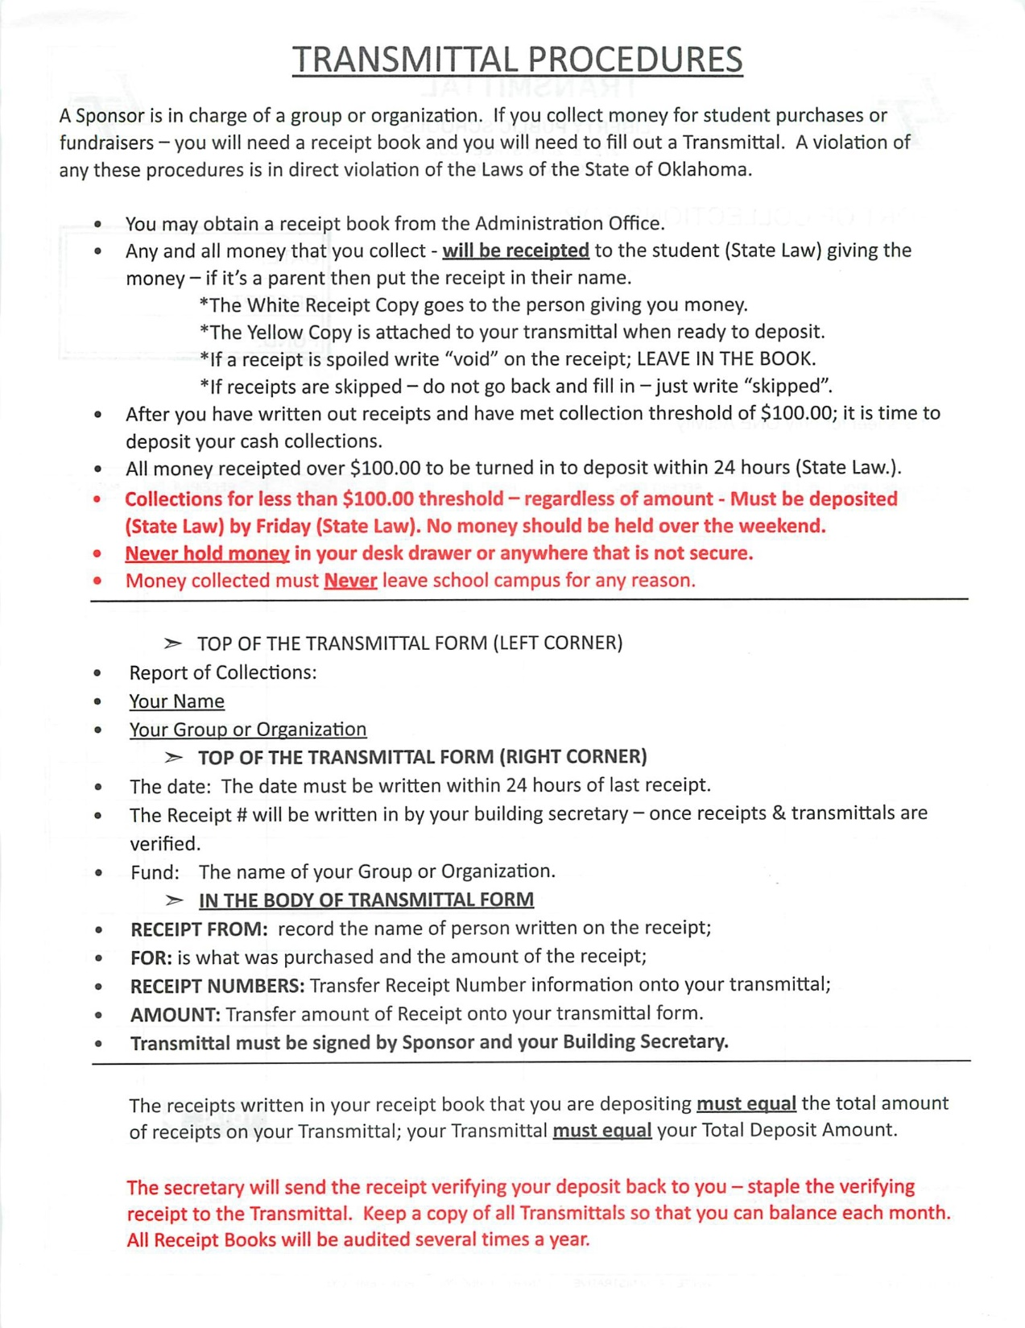
Transmittal (sample)

Slide 19
Communication
Communication is the key to getting information to parents - do not forget about everyone else at school that may have an interest In the activities you have planned. As a sponsor if you are primarily communicating with parents through Facebook you are leaving out a very Important group of people – that would be everyone else besides your group of parents.
Only the district’s website and Facebook page are official avenues of communication. Individual club or team social media messages should be linked to the district’s official communication outlets.

Slide 20
Acknowledgement of Activity Fund Toolkit Presentation 08/23/2023
By signing this form I am acknowledging the fact that I have been informed and have received information covering the following topics:
Activity Fund Law
Responsibility of the Building Principal; Sponsors; Secretary; Activity Fund Custodian
Purchase Order Procedures for Activity Fund.
Procedures for making a school purchase.
Procedures for Fundraisers
Procedures for collecting and receipting money
Samples of forms
Purchase Order Cut – Off Date April 15th every year
This information will be posted on the Employee Resource Tab for future reference.
_________________________________________________________________________
Employee Name – Please sign and Print

